Slide 1


Motivation
Digital surveillance is the golden source to monitor the pandemics
Understand and enact on the true concerns of Milwaukee county citizens
Effective Test-Track-Treat
Design, target, and evaluate public education campaigns, Improve policy changes and prediction accuracy of models

Slide 2
Problems Addressing
How does the Public Mask Mandate in the county impacts the search for all COVID-19 symptoms?
What are the highly correlated and impacted symptom search terms with the daily confirmed COVID-19 cases and fatalities before and after the mask mandate policy?
How are vaccination intent and side effect search terms correlated with mask mandate policies?

Slide 3
How is it Human Centered?
People-Centered
(embedding the end users' thoughts and concerns)
Participatory Design
(real-time, immediate, quick, and cheap feedback)
Ethical
(Masked data and free of demographic bias)
Viable
(Possible data incorporation and implementation)

Slide 4
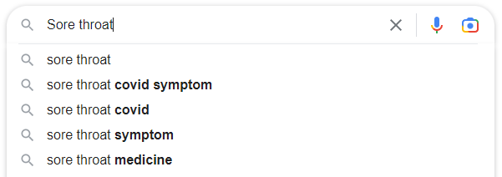
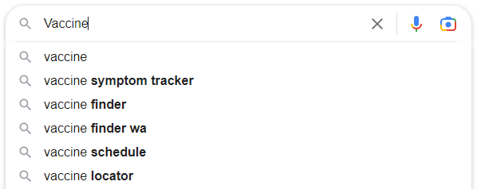
Data Used
Data Source 1: COVID-19 Search Trends symptoms dataset
Aggregated and anonymized relative symptom search trends in Google for more than 400 health symptoms, signs, and conditions.
Data Source 2: COVID-19 Vaccination Search Insights
Aggregated and anonymized relative interest in Google searches related to COVID-19 vaccination, intention and side-effects.

Slide 5
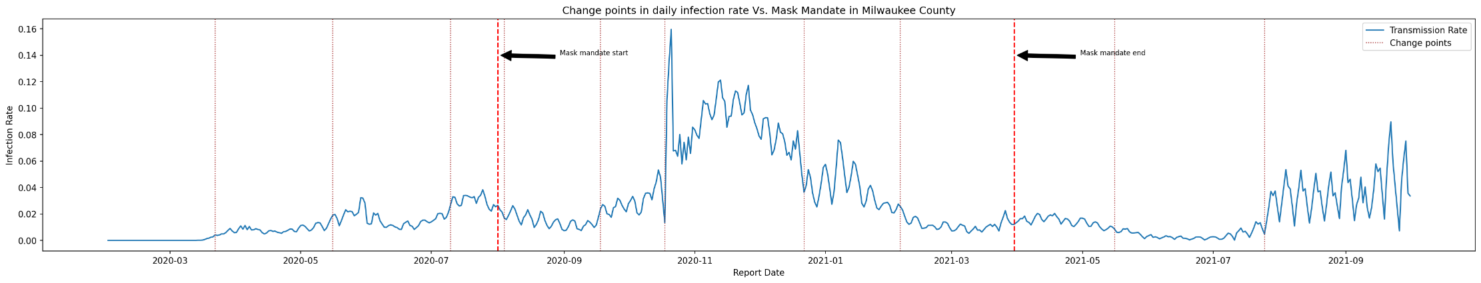
Change Point Detection
What?
Change point detection (CPD) finds abrupt changes in time series when the property of signal changes
Why?
Identify the pivot points in virus progression and draw inference for detected changes
How?
Ruptures – Detect the change in derivative of the infection rate

Slide 6
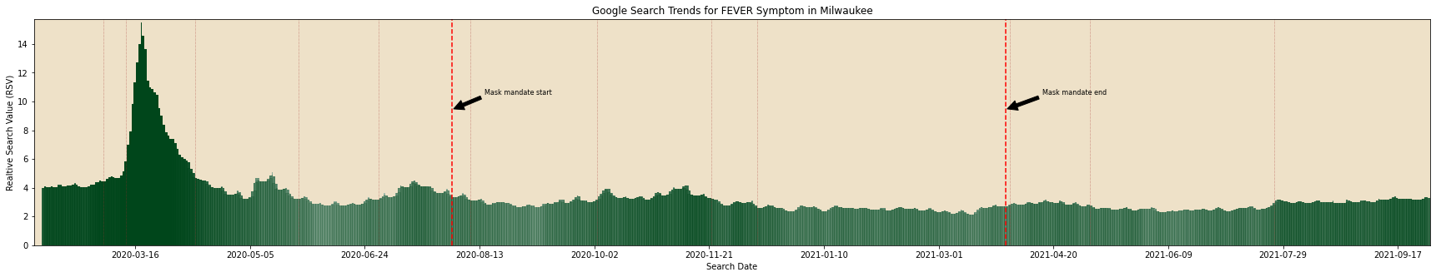
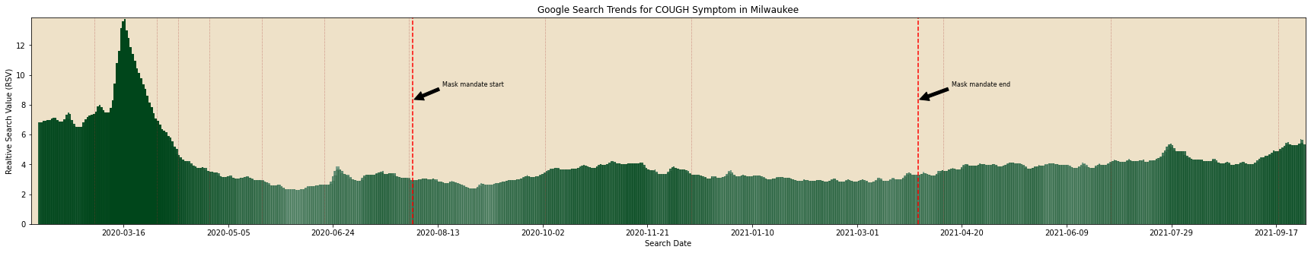
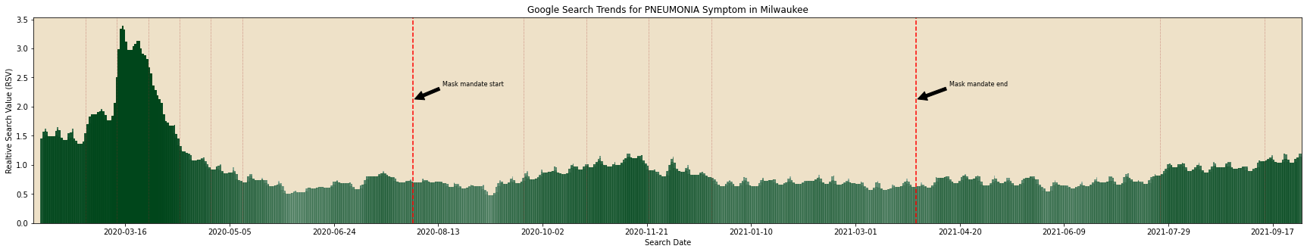
Google Symptom Search Trends
FEVER symptom search term is strongly associated with daily COVID-19 confirmed cases
Change points detected for search term closely align with those of the infection rate
COUGH is the highest searched symptom with high RSV
Moderately correlated with COVID-19 confirmed cases
PNEUMONIA symptom search term is strongly associated with daily COVID-19 fatalities
Lag delay observed in change points between search term and fatalities

Slide 7
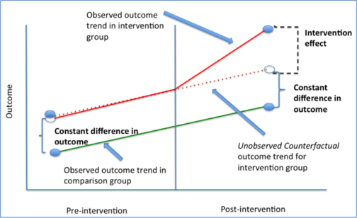
Difference-in-Difference (DID)
What?
DID is an experimental design technique that uses longitudinal data to estimate a causal effect
Why?
Estimate the effect of mask mandate on Symptom searches (proxy for symptoms) by comparing the counties
How?
Fit a regression line between the control group (other county) and treatment group (Milwaukee) and obtain the coefficients

Slide 8
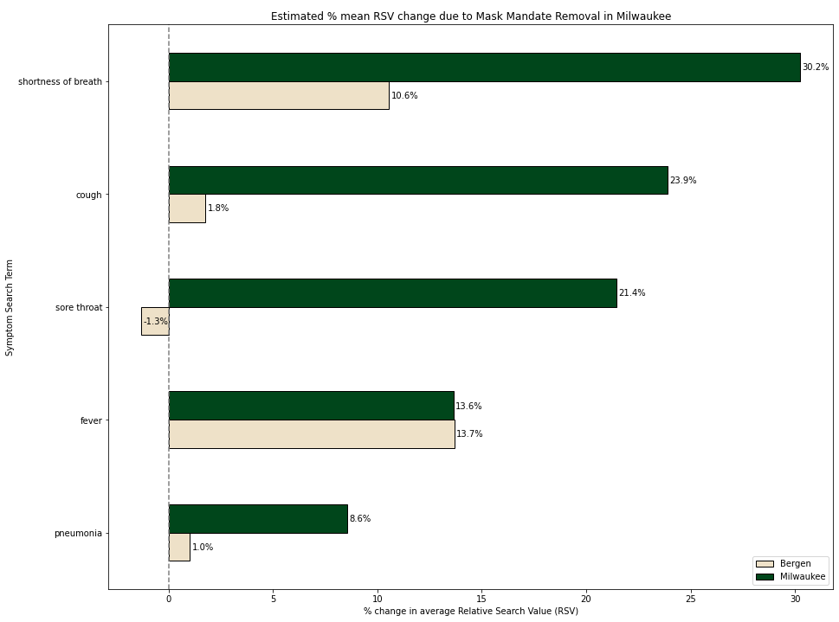
Impact of Mask Mandate Removal
Shortness of Breath is highly impacted by the removal of mask mandate in Milwaukee county (20% greater than other county with continuous mask mandate)
Fever symptom search growth rate is approximately same without mask mandate
Pneumonia symptom search term is the least impacted with decent RSVs

Slide 9
Rolling Windowed Time Lagged Correlation
What?
Windowed TLCC is a synchrony measurement technique which obtains the correlation values with lag between signals
Why?
Identify directionality, synchrony and leader-follower relationship between symptom searches and COVID-19 daily confirmed cases
How?
Uses sliding window offset and calculates Pearson correlation values for each lag value between the cases and COVID-19 top searched symptoms

Slide 10
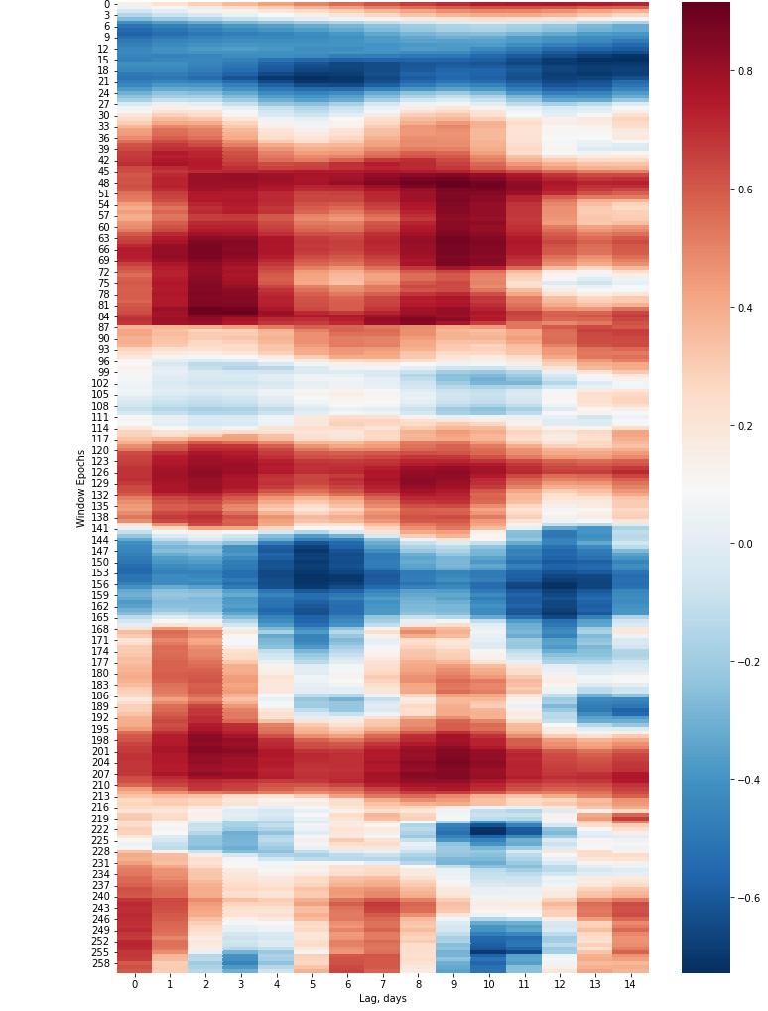
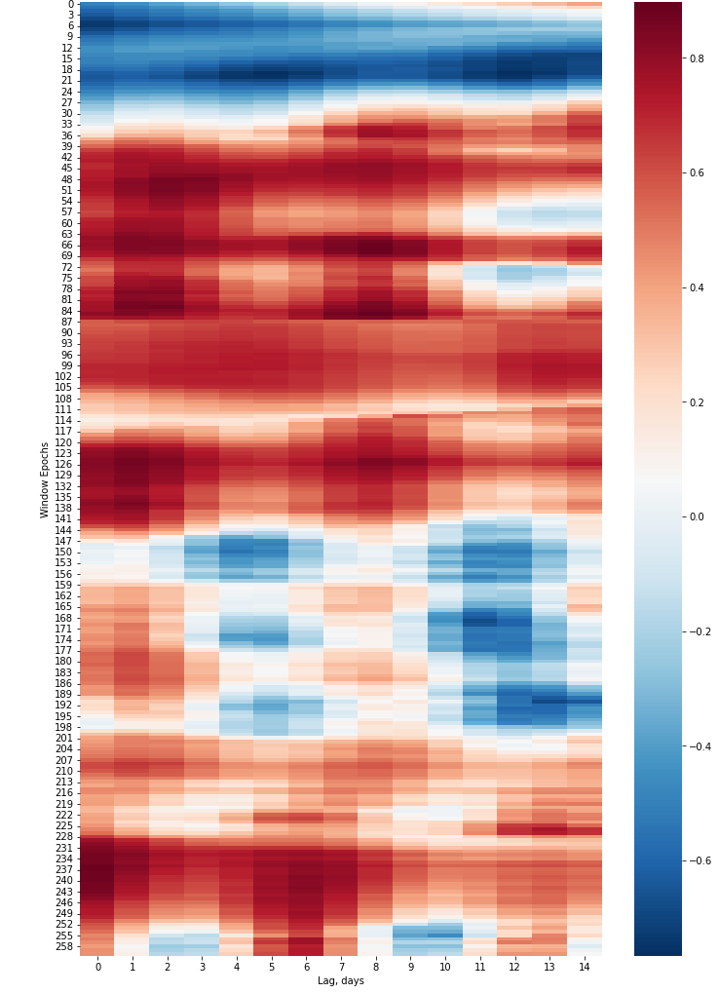
Correlation Takeaways 1 (SHORTNESS OF BREATH and PNEUMONIA)
Shortness of Breath search term is strongly correlated with lag of 4 days when there is no mask mandate
Pneumonia search term is highly correlated at day 11 with confirmed cases and fatalities
Mask Mandate Started
5th Change Point
8th Change Point
Mask Mandate Ended

Slide 11
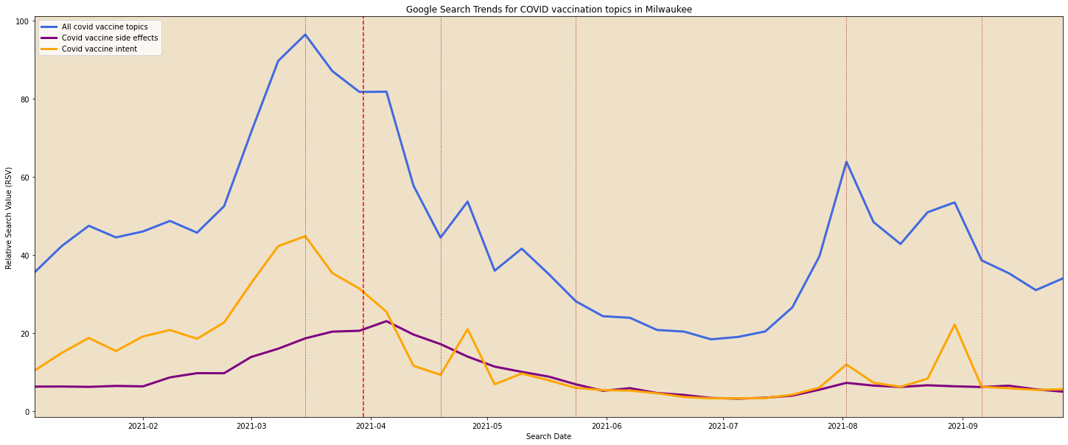
Vaccination Interest
May 23rd: Final day the FEMA mass vaccination and low transmission rate
August 13th: Governor announced $100 VISA gift card for vaccinated people
January 14th: Reported confusion about vaccine eligibility in the Milwaukee county
March 5th: Delayed skin reactions reported in County after first dose Moderna vaccines
April 13th: CDC, FDA recommend pausing J&J vaccine
February 23rd: FDA announced expedite trials with vaccine boosters
April 19th: Vaccine eligibility for all adults announced in Milwaukee County
May 5th: Pause on J&J COVID-19 vaccine lifted and Alpha variant detected
May 5th: Pause on J&J COVID-19 vaccine lifted
Sep 20th: COVID-19 booster shots made available

Slide 12
Why do these Results Matter?
Regression analysis helps improve the mask mandate policy and understand the health concerns of people before being hospitalized
Correlation analysis stresses on the urgency of treatment for citizens by understanding the common symptoms
Both analysis combined will help in isolating, tracking and treating the citizens of Milwaukee effectively

